Slide 1
BLOCKCHAIN VOTING SYSTEM
PROJECT GUIDE: PRESENTED BY:
Smt.Premy P Jacob ANUGRAH R K
ROLL NO:12
MCA-S3

Slide 2
Introduction
This project presents an online voting system leveraging blockchain technology to enhance security, transparency, and trust in electoral processes. This approach offers a promising solution for free and fair elections, addressing key challenges in traditional voting systems.

Slide 3
Literature review
Blockchain-Based E-Voting Systems: A Technology Review(2023)
E-Voting Using Blockchain: A Systematic Literature Re-view (2020)
Blockchain-Based Electronic Voting System Design with SmartContracts (2021)
Security Challenges and Solutions for Blockchain in E-VotingSystems (2020)
Blockchain-Based Voting Systems: Enhancing Security andTransparency in Online Elections (2022)

Slide 4
Problem Statement
Traditional voting systems face significant challenges related to trust, transparency, and security, with concerns about vote tampering, fraud, and mismanagement. Protecting voter privacy and ensuring the security of sensitive voting data is difficult, and many systems fail to offer adequate accessibility for all voters, particularly those in remote areas or with disabilities.

Slide 5
EXISTING SYSTEM:
Security Risks: Prone to hacking, data breaches, and tampering.
Transparency Issues: Reliance on central authorities raises doubts about the accuracy and fairness of results.
Scalability Challenges: Difficulty handling large voter volumes, leading to slowdowns and potential system failures.

Slide 6
PROPOSED SYSTEM:
Decentralization: The system operates on a decentralized network, eliminating the need for a central authority.
Security and Integrity: Blockchain's cryptographic features ensure that once a vote is cast, it is securely recorded in an immutable ledger.
Transparency and Auditability: Every vote is recorded on a public ledger that can be audited by any participant, ensuring full transparency.

Slide 7
REQUIREMENT SPECIFICATIONS:
Minimum Hardware Specifications:
Processor : Intel® core i5
RAM: Minimum 8GB
Storage: Minimum 256GB(SSD)
Graphics: Recommended
Operating System: Windows 10 or 11
Front-end:React.js, TypeScript(.tsx), SCSS
Back-end: Node.js, TypeScript(.ts),Solidity
Database: MySQL
Frameworks/Libraries: Express.js, Web3.js, Truffle
Software Specifications:

Slide 8
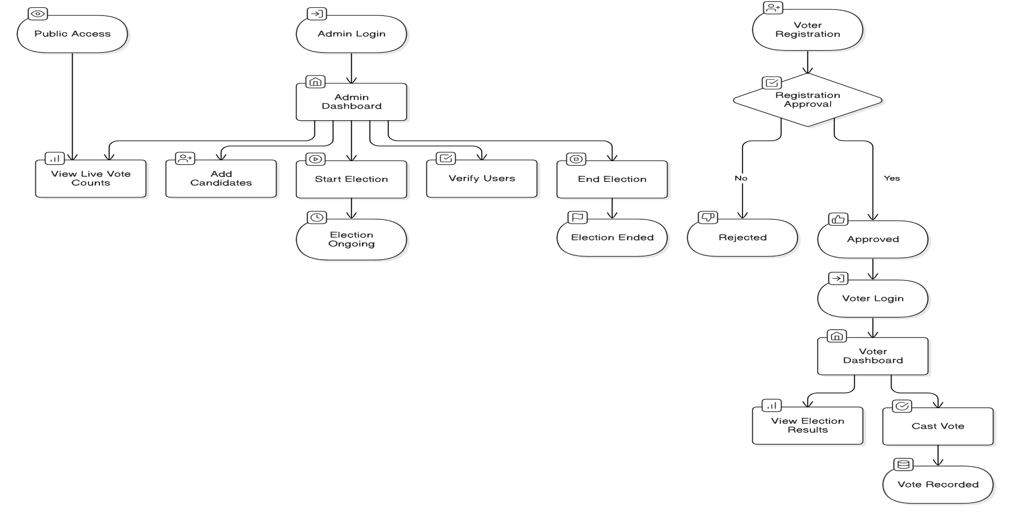
System Architecture

Slide 9
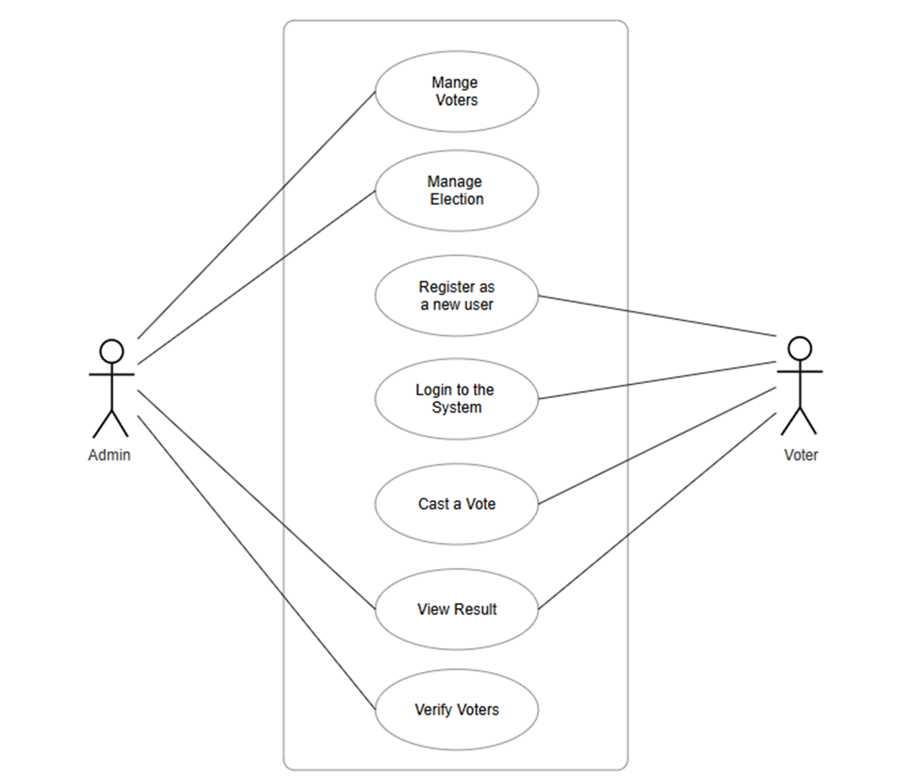
UseCase Diagram

Slide 10
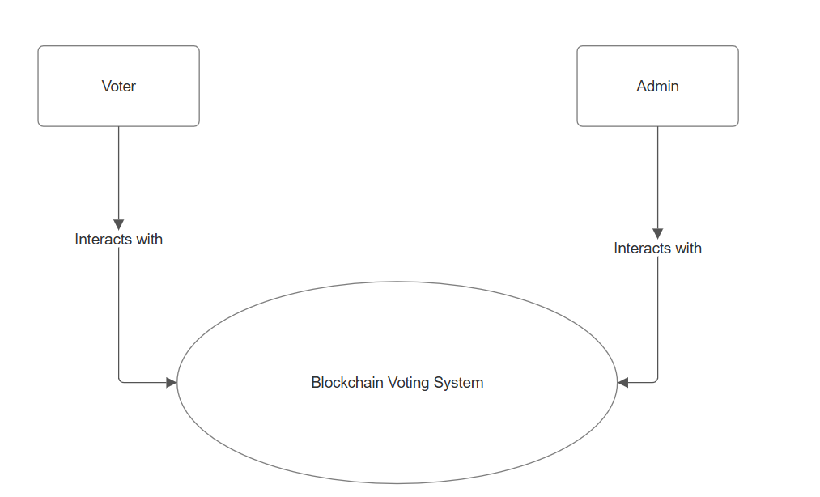
DFD(Level-0)

Slide 11
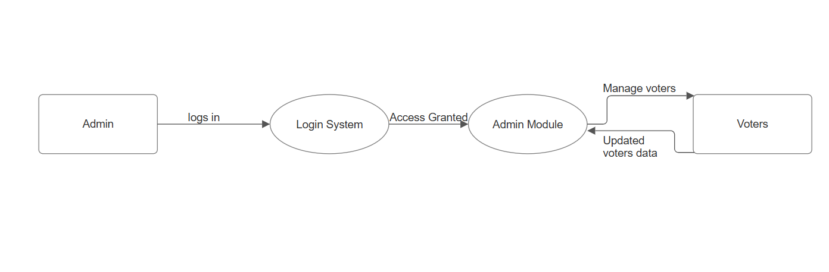
DFD-Admin(Level-1)

Slide 12
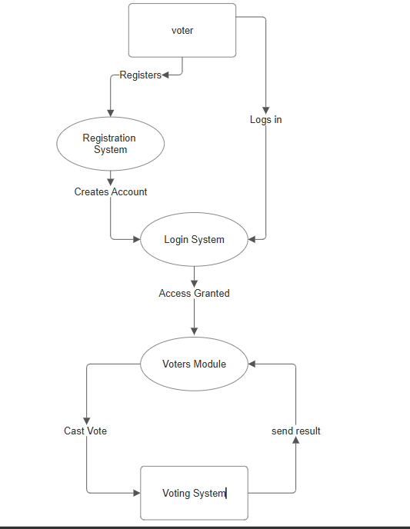
DFD-Voter(level-1)

Slide 13
TEST CASES
User Authentication and Authorization
Test Case | Description | Steps | Expected Result
1. User Registration | Verify that a new user can register successfully. | 1. Navigate to the registration page. 2. Enter valid details and submit. | User is registered successfully and redirected to login page.
2. User Login | Ensure only registered users can log in. | 1. Go to login page. 2. Enter valid credentials and submit. | User is successfully logged in and redirected to home page.
3. Admin Login | Verify that only an admin can access the admin dashboard. | 1. Log in with an admin account. 2. Check access to the admin dashboard. | Admin has access; non-admin users do not.

Slide 14
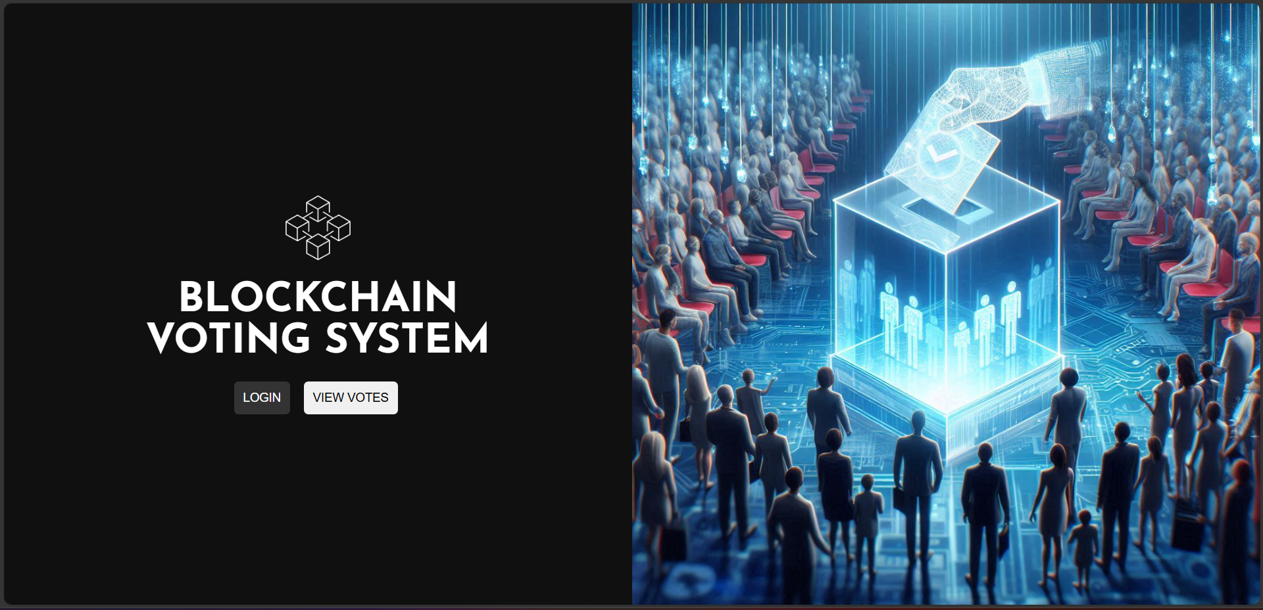
Work Done (Screenshots)
Home page

Slide 15
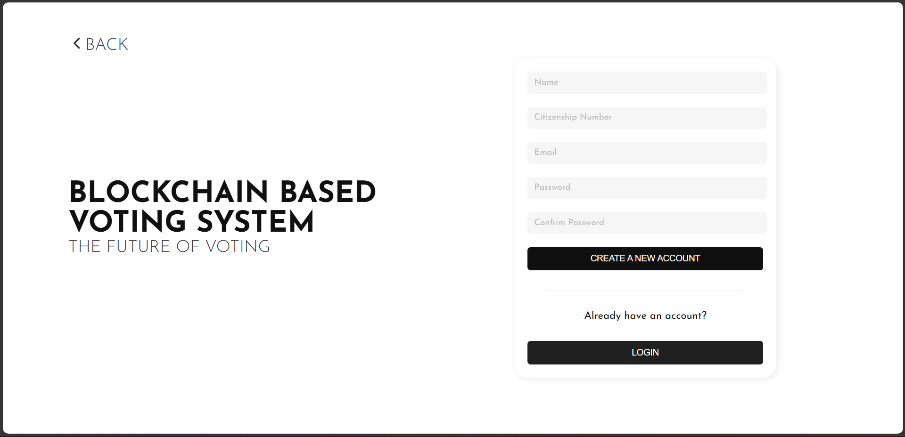
Work Done (Screenshots)
Voter Registration Page

Slide 16
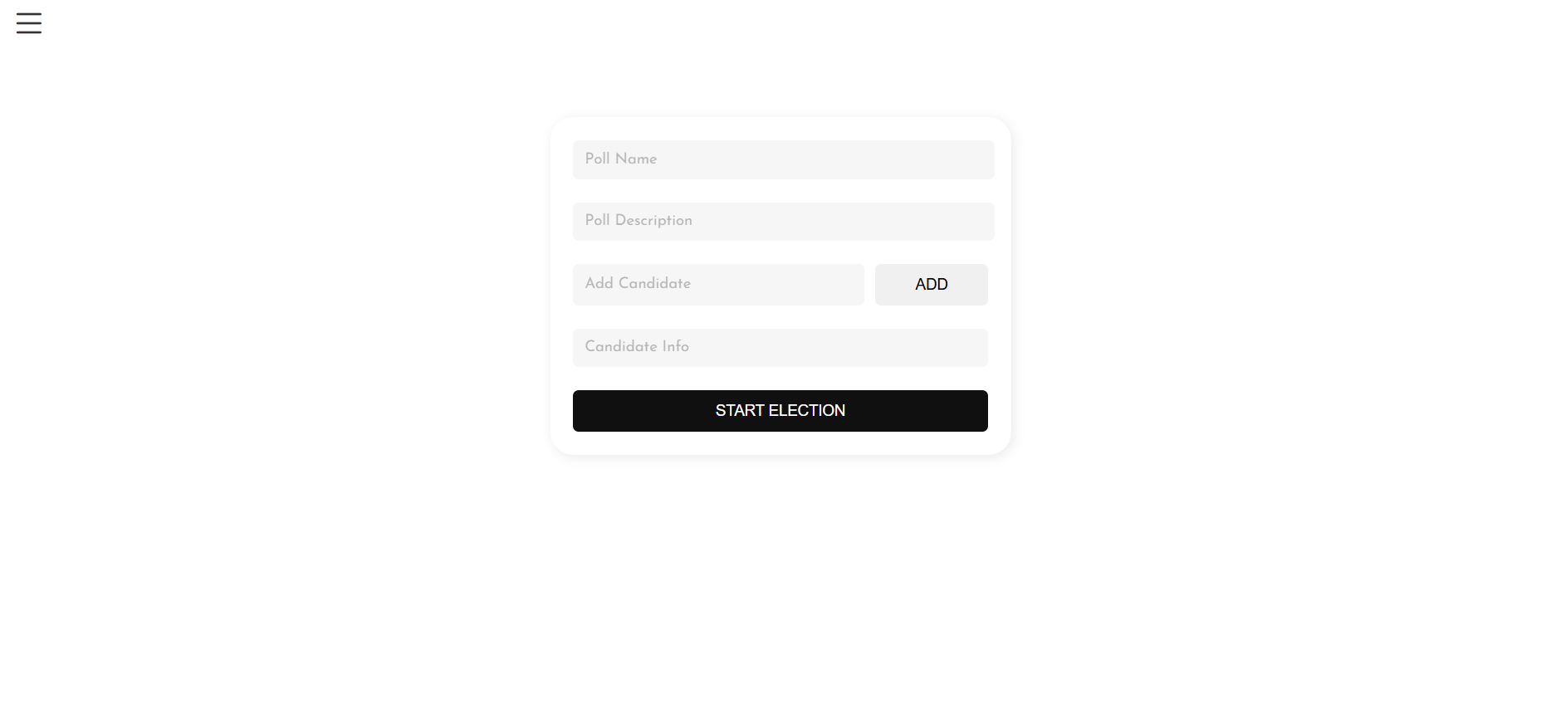
Work Done (Screenshots)
Start Election Page

Slide 17
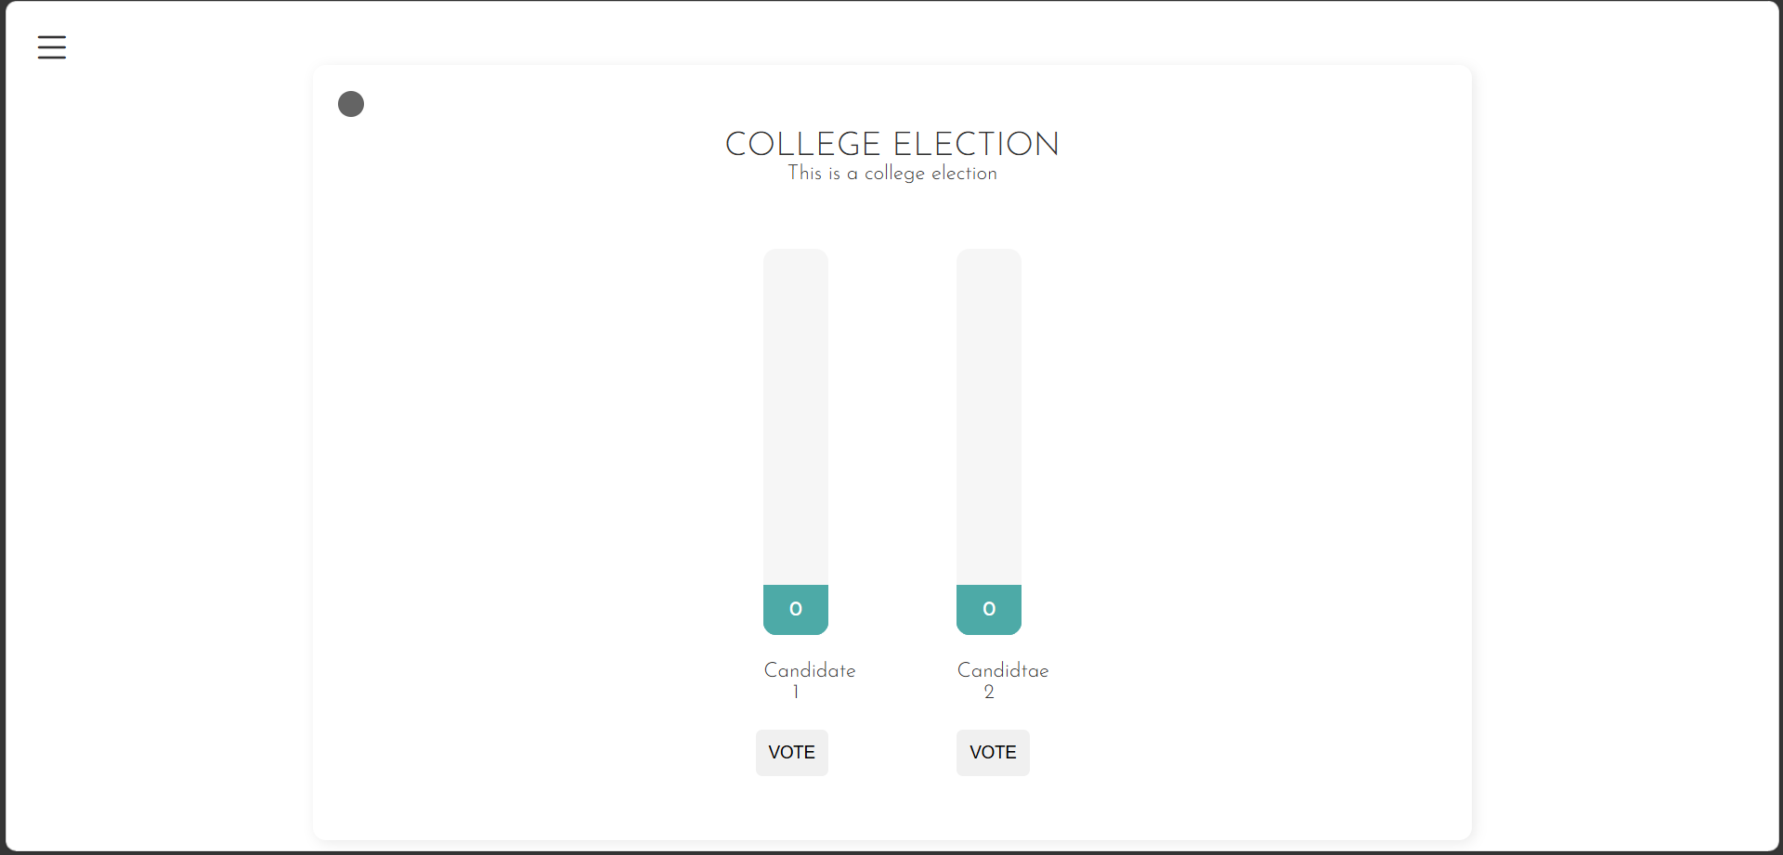
Work Done (Screenshots)
Voting Page

Slide 18
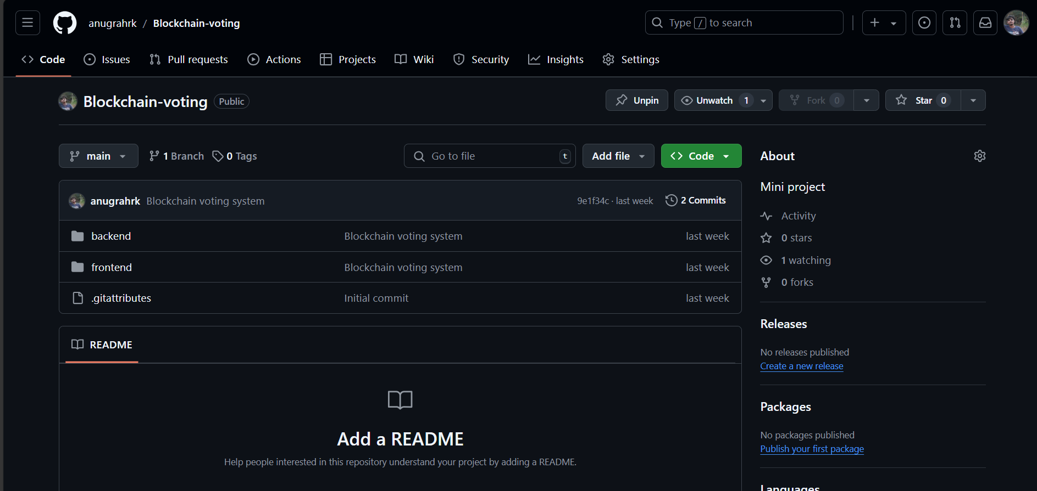
Github History

Slide 19
Future Scope
Improved Scalability and Performance
Enhanced User Verification
Integration with Multi-Blockchain Networks
Voter Privacy and Anonymity
Mobile and Accessibility Enhancements
Integration with Government and Corporate Elections

Slide 20
Conclusion
In conclusion, implementing a blockchain-based voting system presents a transformative solution to many of the challenges associated with traditional voting methods. By leveraging the decentralized, transparent, and secure nature of blockchain technology, such a system can enhance voter trust, ensure data integrity, protect privacy, and streamline the voting process.

Slide 21
References
Blockchain based Secure Voting System, Divya Kumari; Nitish Veni
Votereum: Blockchain based Secure Voting System | IEEE Conference Publication | IEEE Xplore
E-Voting System Using Blockchain Technology, Abhishek Tekade BE-CS Savitribai Phule Pune University, Pune
“E-Voting System Using Blockchain Technology”
Blockchain-Based E-Voting System, Friðrik Þ. Hjálmarsson, Gunnlaugur K. Hreiðarsson School of Computer Science Reykjavik University, Iceland
Research-Paper-BBEVS.pdf
A guide to developing an Ethereum decentralized voting application, By Timothy Ko
A guide to developing an Ethereum decentralized voting application

Slide 22


